Slide 1
Dumbways Bootcamp DevOps!
Khaerul Anwar
Persentasi Week 3

Slide 2
Materi
Docker
Install Jenkins
Create Docker Image
Install Application
Jenkins
Install Jenkins
Create Jenkins Job
Slack Notification

Slide 3
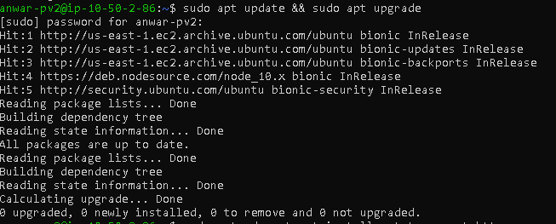
Docker Installation
1
Let’s start with the first set of slides

Slide 4
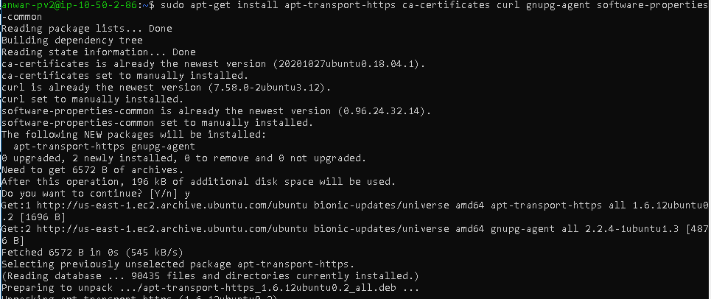
Transition headline
Docker Installation
2
Let’s start with the first set of slides

Slide 5
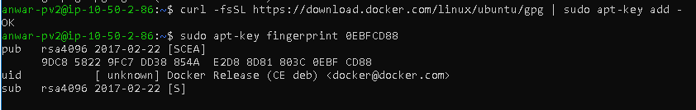
Docker Installation
3

Slide 6
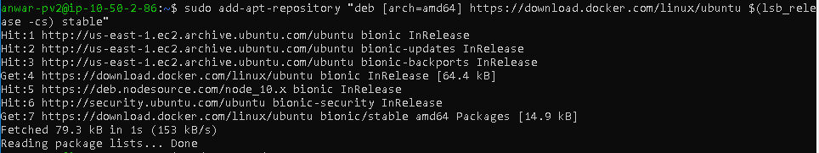
Docker Installation
4

Slide 7
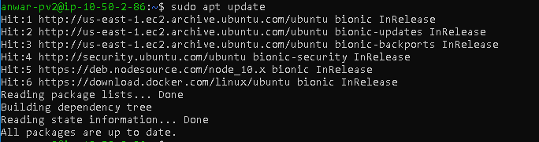
Transition headline
Docker Installation
5

Slide 8
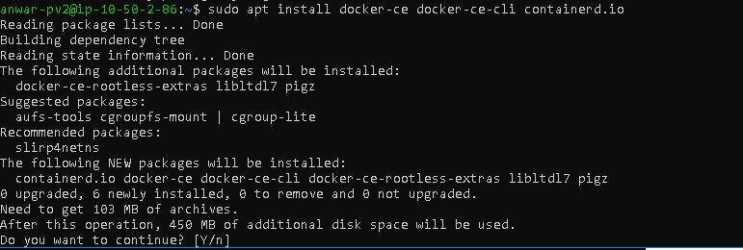
Transition headline
Docker Installation
6
Let’s start with the first set of slides

Slide 9
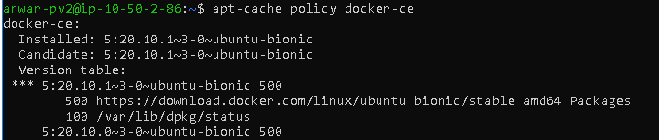
Transition headline
Docker Installation
7

Slide 10
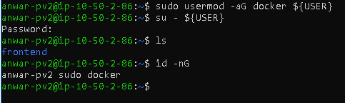
Transition headline
Docker Installation
8

Slide 11
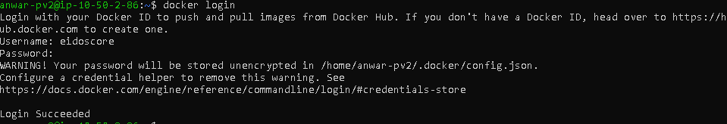
Docker Installation
9

Slide 12
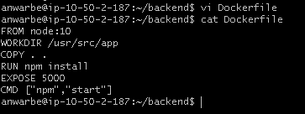
Transition headline
Create Docker Image
10
Let’s start with the first set of slides

Slide 13
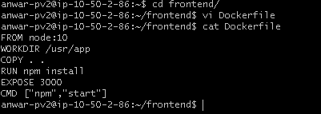
Transition headline
Create Docker Image
11
Let’s start with the first set of slides

Slide 14

Create Docker Image
12

Slide 15
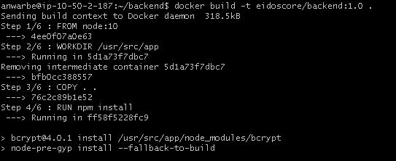
Transition headline
Create Docker Image
13
Let’s start with the first set of slides

Slide 16
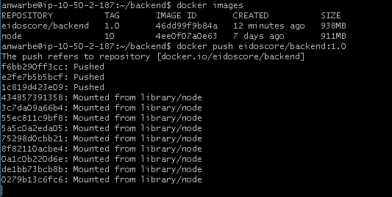
Transition headline
Create Docker Image
14
Let’s start with the first set of slides

Slide 17
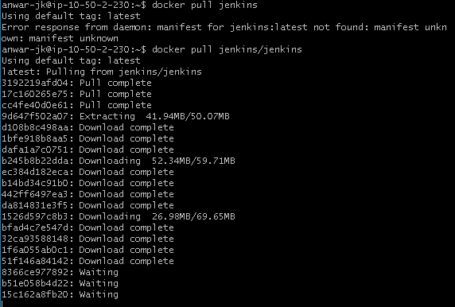
Transition headline
Jenkins Installation
15
Let’s start with the first set of slides

Slide 18
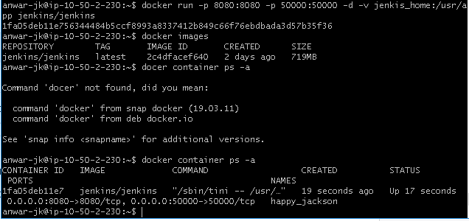
Transition headline
Jenkins Installation
16
Let’s start with the first set of slides

Slide 19
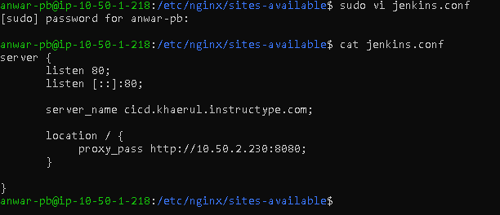
Transition headline
Jenkins Installation
17
Let’s start with the first set of slides

Slide 20
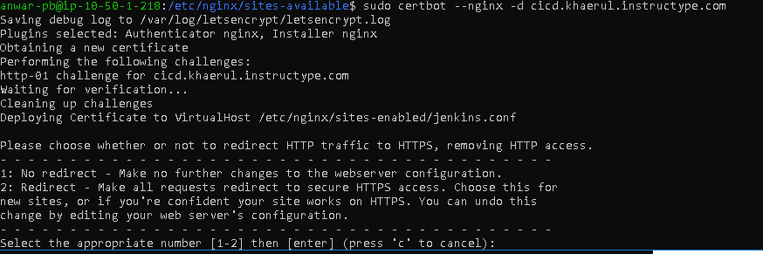
Transition headline
Jenkins Installation
18
Let’s start with the first set of slides

Slide 21

Jenkins Installation
19

Slide 22
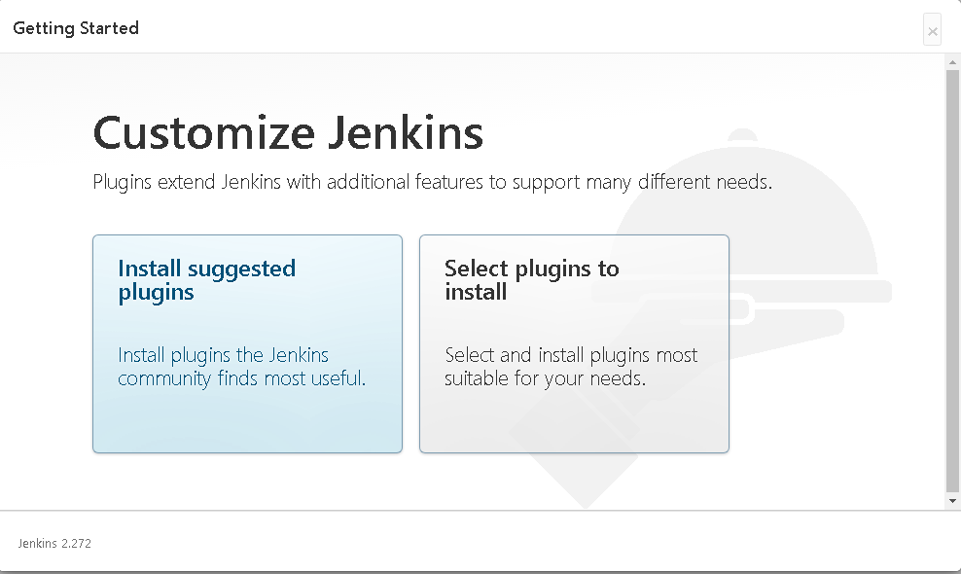
Transition headline
Jenkins Installation
20
Let’s start with the first set of slides

Slide 23
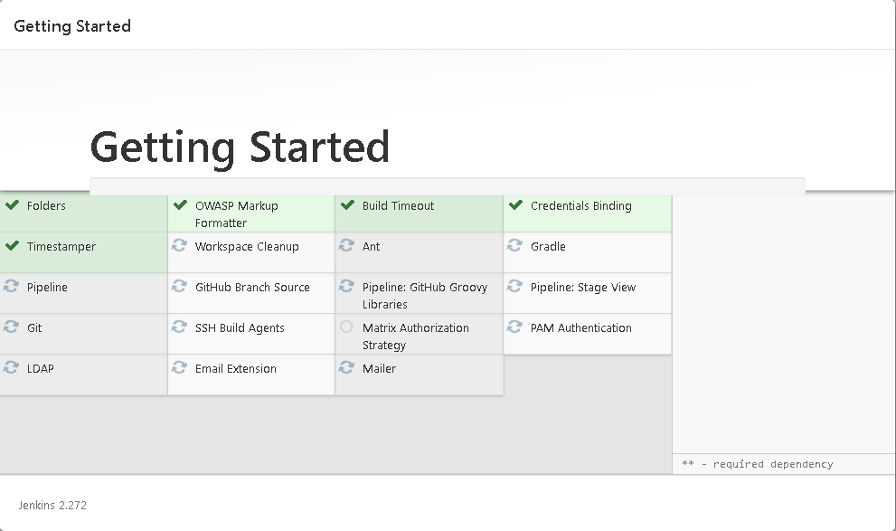
Transition headline
Jenkins Installation
21
Let’s start with the first set of slides

Slide 24
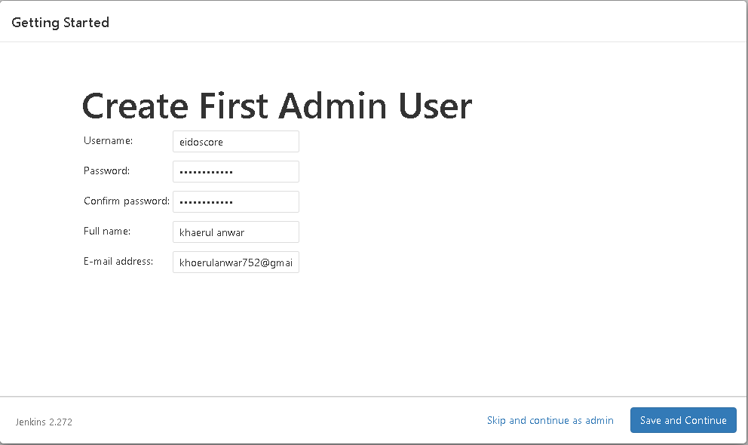
Transition headline
Jenkins Installation
22
Let’s start with the first set of slides

Slide 25
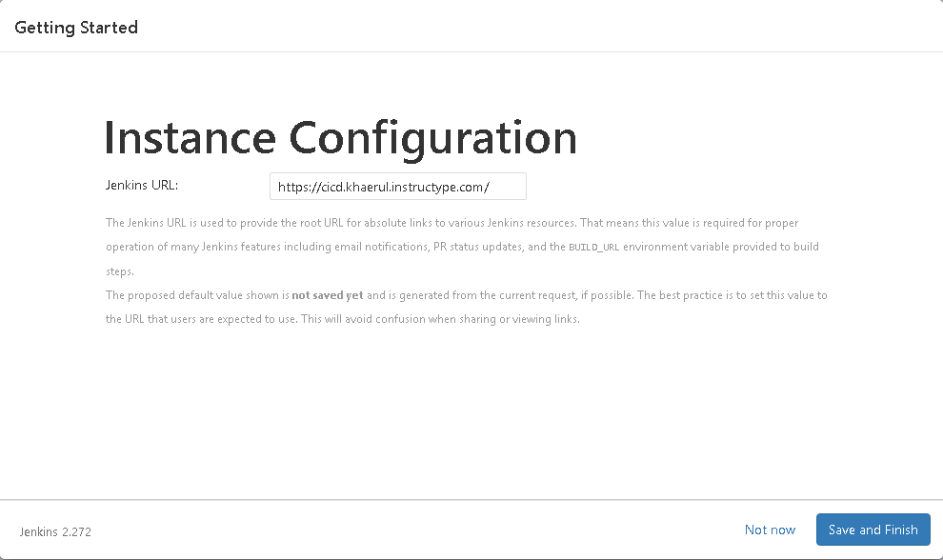
Transition headline
Jenkins Installation
23
Let’s start with the first set of slides

Slide 26
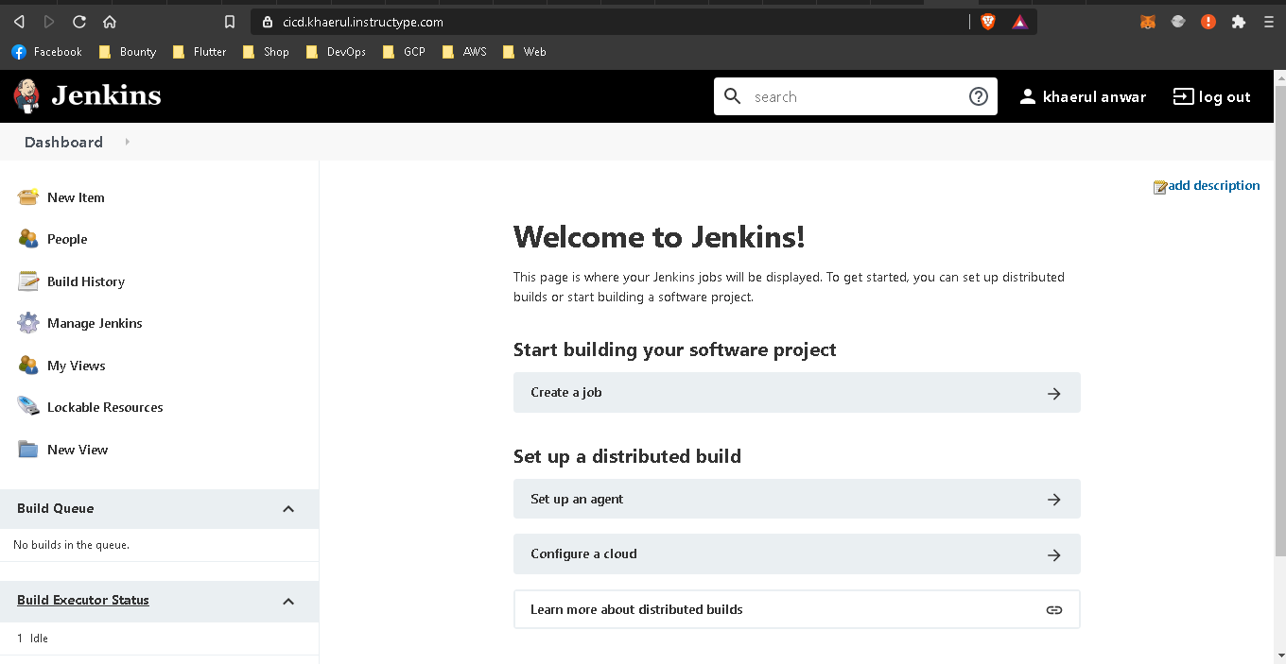
Transition headline
Jenkins Installation
24
Let’s start with the first set of slides

Slide 27
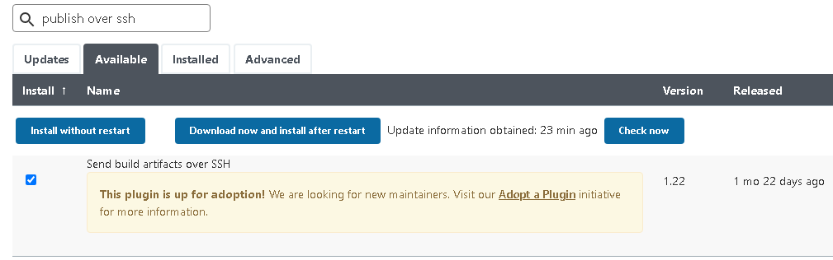
Transition headline
Jenkins Installation
25
Let’s start with the first set of slides

Slide 28
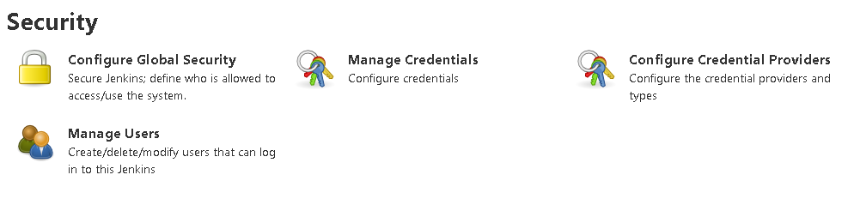
Transition headline
Jenkins Installation
26
Let’s start with the first set of slides

Slide 29
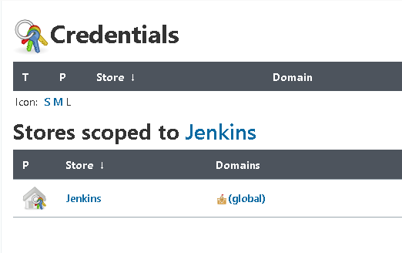
Transition headline
Jenkins Installation
27
Let’s start with the first set of slides

Slide 30
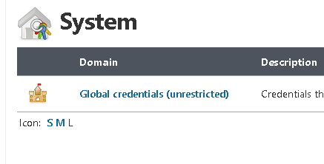
Transition headline
Jenkins Installation
28
Let’s start with the first set of slides

Slide 31
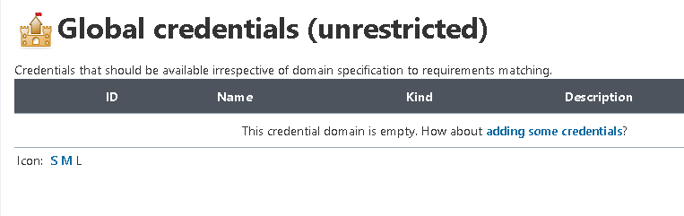
Transition headline
Jenkins Installation
29
Let’s start with the first set of slides

Slide 32
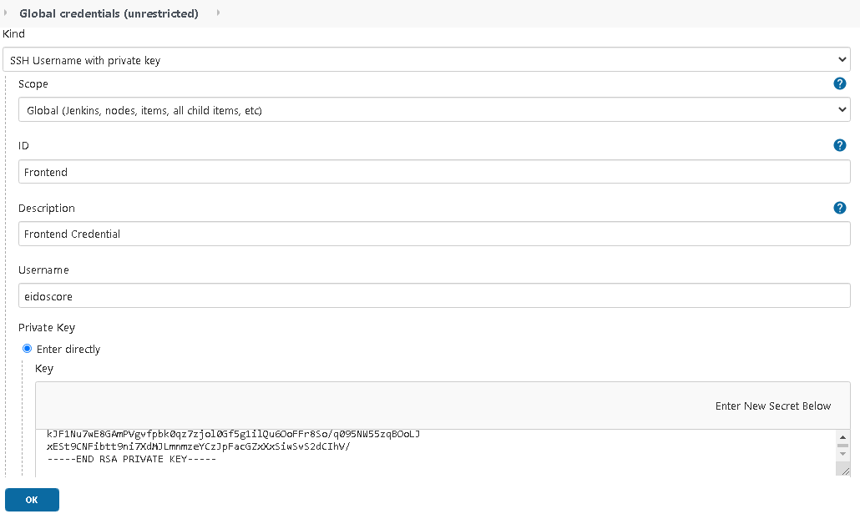
Transition headline
Jenkins Installation
30
Let’s start with the first set of slides

Slide 33
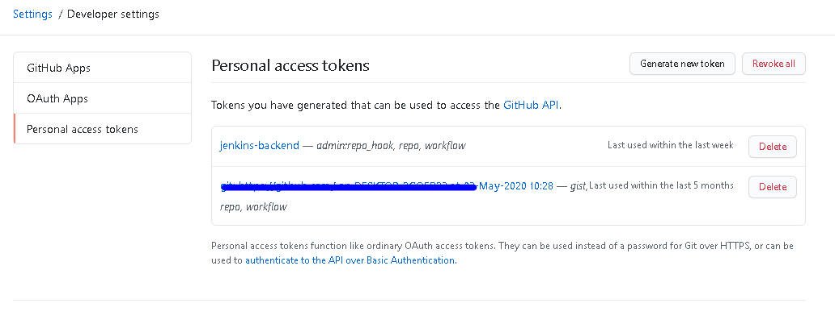
Transition headline
Jenkins Installation
31
Let’s start with the first set of slides

Slide 34
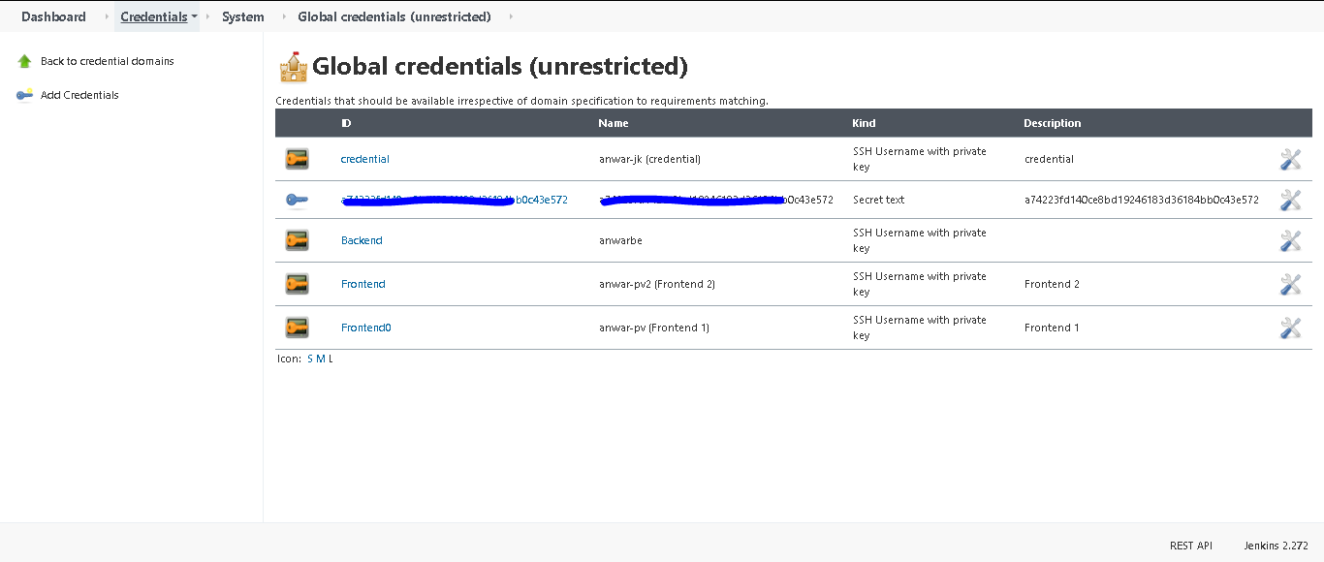
Transition headline
Jenkins Installation
32
Let’s start with the first set of slides

Slide 35
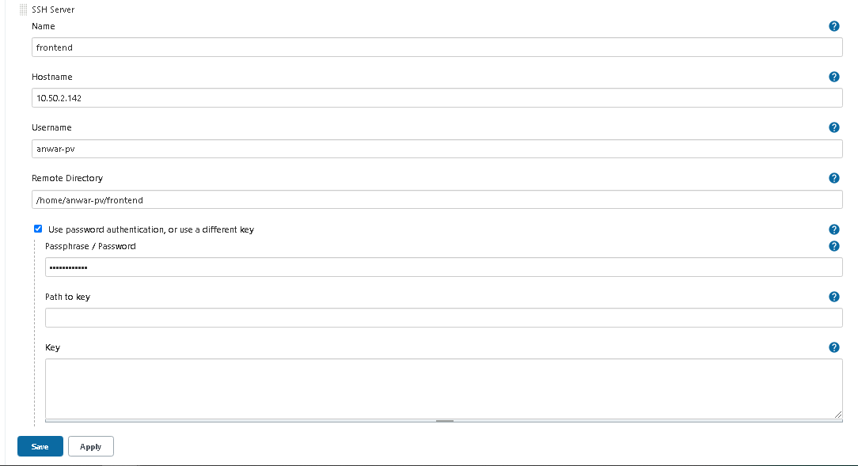
Transition headline
Jenkins Installation
33
Let’s start with the first set of slides

Slide 36
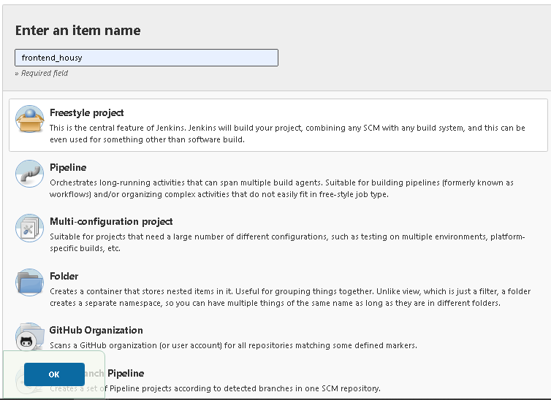
Transition headline
Jenkins Installation
34
Let’s start with the first set of slides

Slide 37
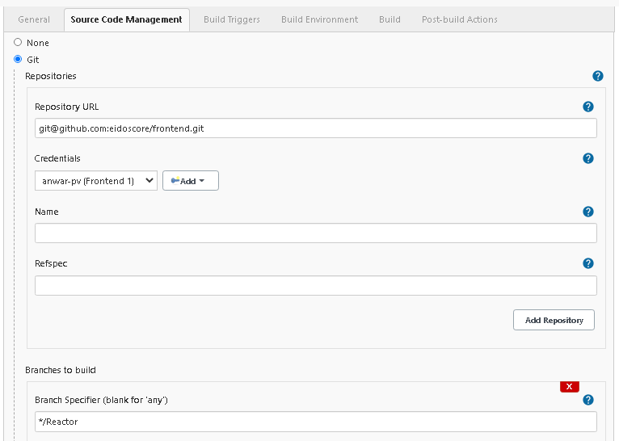
Transition headline
Jenkins Installation
35
Let’s start with the first set of slides

Slide 38
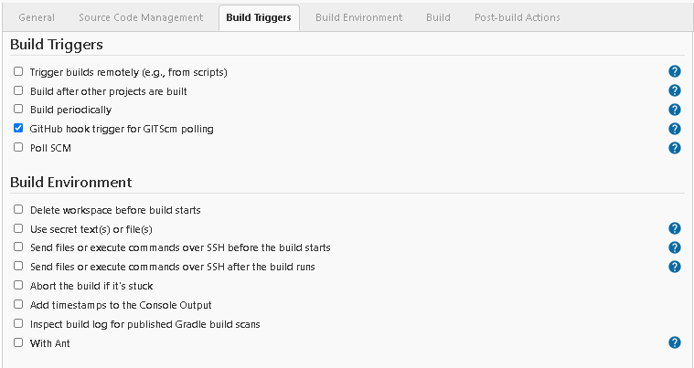
Transition headline
Jenkins Installation
36
Let’s start with the first set of slides

Slide 39
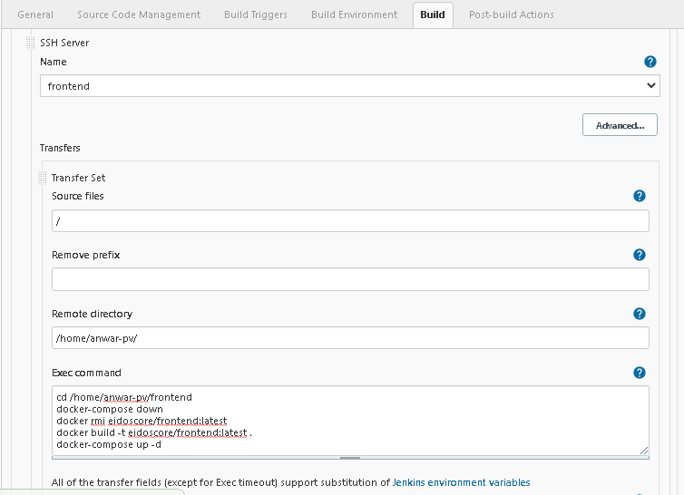
Transition headline
Jenkins Installation
37
Let’s start with the first set of slides

Slide 40
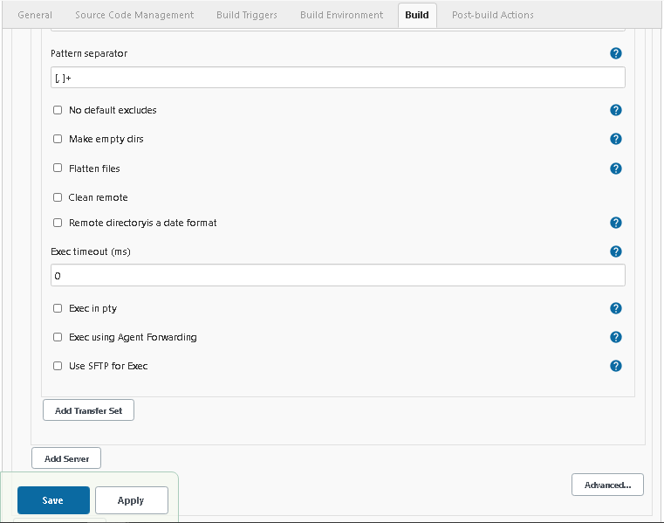
Transition headline
Jenkins Installation
38
Let’s start with the first set of slides

Slide 41
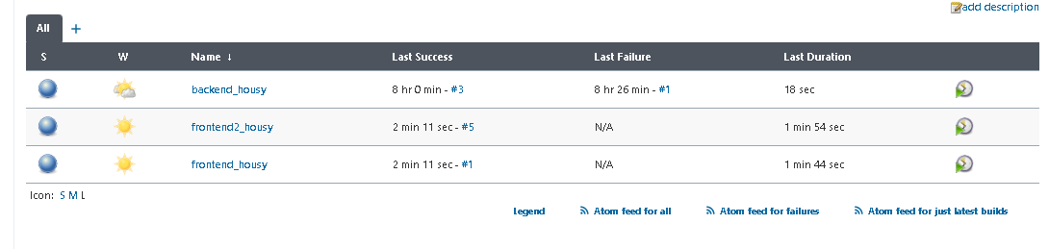
Transition headline
Jenkins Installation
39
Let’s start with the first set of slides

Slide 42
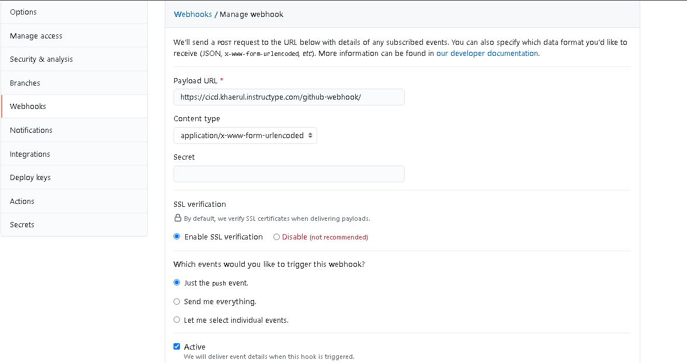
Transition headline
Jenkins Installation
40
Let’s start with the first set of slides

Slide 43
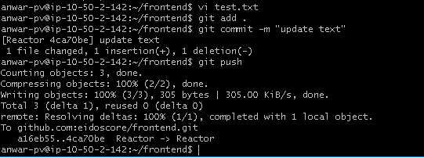
Transition headline
Jenkins Installation
41
Let’s start with the first set of slides

Slide 44
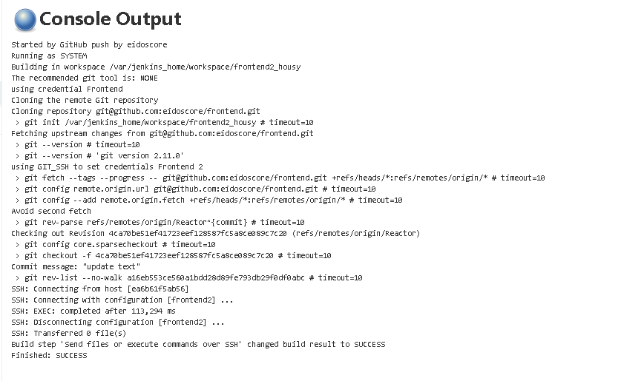
Transition headline
Jenkins Installation
42
Let’s start with the first set of slides

Slide 45
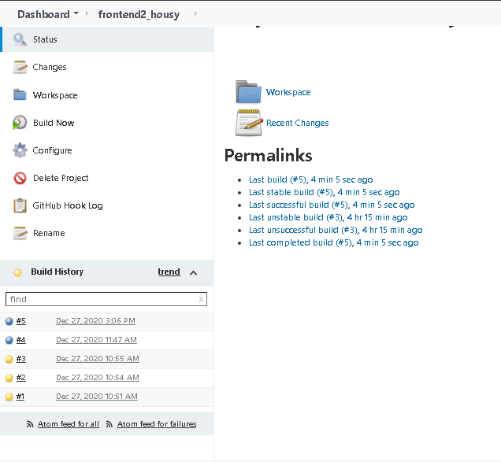
Transition headline
Jenkins Installation
43
Let’s start with the first set of slides

Slide 46
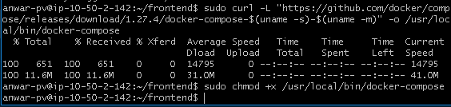
Transition headline
Jenkins Installation
44
Let’s start with the first set of slides

Slide 47
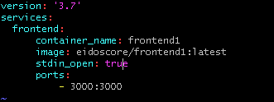
Transition headline
Jenkins Installation
45
Let’s start with the first set of slides

Slide 48
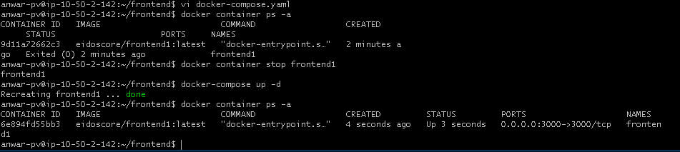
Transition headline
Jenkins Installation
46
Let’s start with the first set of slides

Slide 49
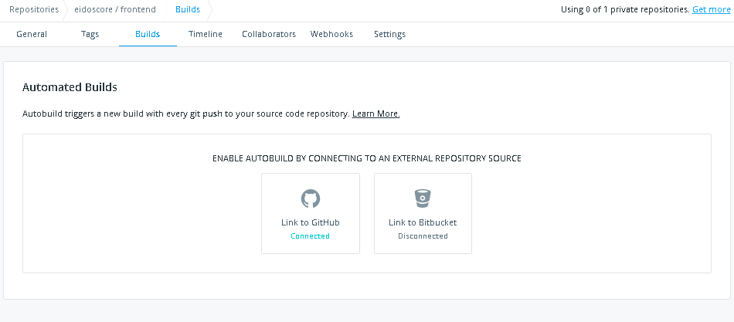
Transition headline
Jenkins Installation
47
Let’s start with the first set of slides

Slide 50
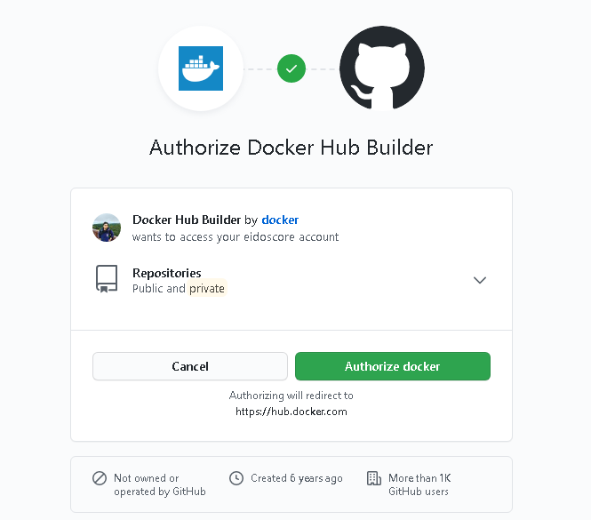
Transition headline
Jenkins Installation
48
Let’s start with the first set of slides

Slide 51
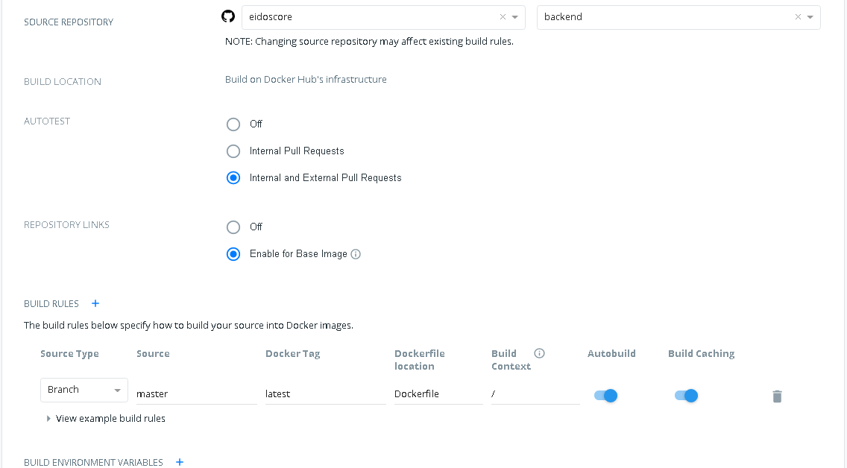
Transition headline
Jenkins Installation
49
Let’s start with the first set of slides

Slide 52
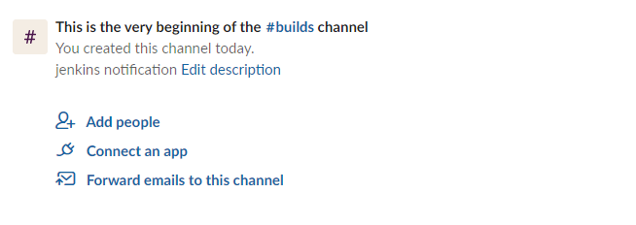
Transition headline
Jenkins Notification - Slack
50
Let’s start with the first set of slides

Slide 53
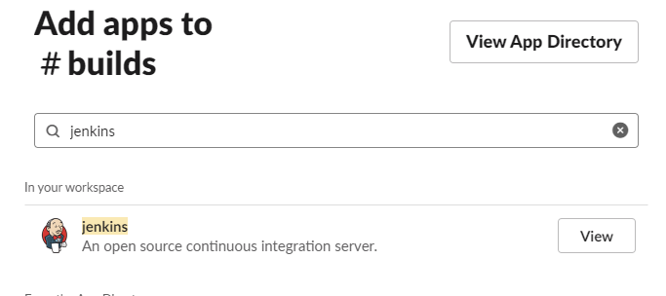
Transition headline
Jenkins Notification - Slack
51
Let’s start with the first set of slides

Slide 54
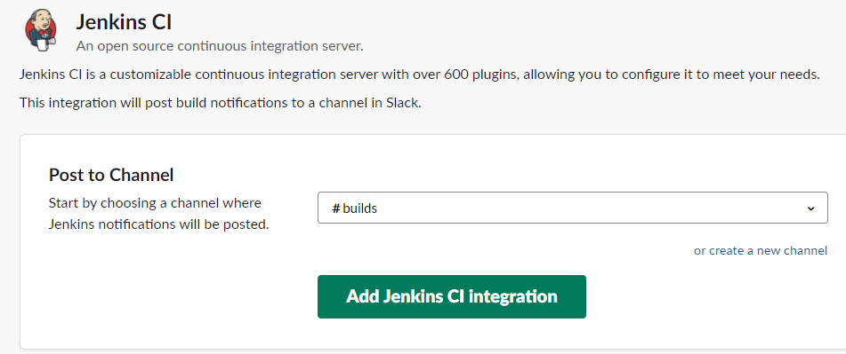
Transition headline
Jenkins Notification - Slack
52
Let’s start with the first set of slides

Slide 55

Transition headline
Jenkins Notification - Slack
53
Let’s start with the first set of slides

Slide 56

Transition headline
Jenkins Notification - Slack
54
Let’s start with the first set of slides

Slide 57

Transition headline
Jenkins Notification - Slack
55
Let’s start with the first set of slides

Slide 58

Transition headline
Jenkins Notification - Slack
56
Let’s start with the first set of slides

Slide 59
Thanks!

